Slide 1
Architecture Fundamentals (.NET )
.NET Core & Microservices
What is Microservices Architecture?
Modular Monolith vs Microservices –
3. Domain-Driven Design (DDD) in Real
Projects
4. Event-Driven Architecture Explained in 60
Seconds
5. Synchronous vs Asynchronous
Communication – Quick Breakdown
6. API Gateway Pattern Using Azure APIM
7. What is Clean Architecture in .NET Core?
8. CQRS and Outbox Pattern – Simplified
9. When to Use Azure Functions vs App
Services vs AKS
10. What are 12-Factor Apps?

Slide 2
Azure Cloud Essentials
Azure Service Bus vs Event Grid –
Azure AD B2C for API Authentication
Azure DevOps CI/CD in Microservices Projects
Azure Logic Apps vs Durable Functions
Cost Optimization in Azure Architecture
How to Migrate from .NET Framework to .NET 8
What is an Azure Landing Zone?
Monitoring with Azure Application Insights
Azure Key Vault – Secure Your Secrets
High Availability with Azure Load Balancer & Deployment Slots

Slide 3
Real Use Cases & Patterns (.NET Azure)
Retail E-Commerce Architecture – Product to Payment Flow
Insurance Use Case – Claims Processing with Microservices
Event Sourcing in .NET – Real-World Example
GitHub Copilot for Faster Development
API Security – OAuth 2.0 and Zero Trust in Azure
Handling Failures with Retry and Circuit Breaker Pattern
Real-Time Notifications using SignalR and Azure Services
Strangler Fig Pattern – Modernizing Legacy Apps
Building an AI Chatbot with Azure Cognitive Services
Logging and Alerting with ELK vs Azure Monitor

Slide 4
Azure API Management – Interview Questions
What is Azure API Management, and when would you use it in a microservices architecture?
Explain the architecture components of Azure API Management.
What are products, APIs, and operations in APIM?
How do you implement rate limiting and throttling in APIM?
What are policies in APIM? Can you name and explain a few common ones?
How do you secure APIs using Azure API Management?
What is the difference between OAuth 2.0 and subscription key in APIM?
How do you manage versioning and revisions of APIs in APIM?
How do you expose internal APIs securely via APIM?
What are inbound, backend, outbound, and error sections in policy configuration?

Slide 5
Azure API Management – Interview Questions
How do you handle request and response transformation in APIM?
How do you enable logging and analytics in Azure API Management?
What is the use of the Developer Portal in APIM?
How can you integrate APIM with Azure Functions or Logic Apps?
What is a self-hosted gateway in APIM? When would you use it?
How do you enforce IP restrictions or geo-fencing in APIM?
How do you implement caching in APIM?
What are SOAP passthrough APIs and how are they handled in APIM?
How do you migrate APIs into Azure APIM from Swagger/OpenAPI?
How do you integrate Azure AD B2C with APIM for API authentication?
What are diagnostics and how do you trace requests in APIM?
How do you expose multiple versions of an API to different clients?
What are the limitations of Azure API Management?
How do you use policy expressions and variables in APIM?
How do you manage CI/CD for APIM configuration?

Slide 6
Azure AD B2C – Interview Questions
What is Azure AD B2C, and how is it different from Azure AD?
What are user flows and custom policies in Azure AD B2C?
When should you use custom policies over built-in user flows?
How do you integrate Azure AD B2C with a .NET Core or Angular application?
What identity providers can be integrated with Azure AD B2C?
How does Azure AD B2C handle multi-factor authentication (MFA)?
How do you customize the login and signup UI in Azure AD B2C?
What is the difference between claims and tokens in Azure AD B2C?
How do you secure APIs using Azure AD B2C?
What is the role of app registration in Azure AD B2C?

Slide 7
Azure AD B2C – Interview Questions
What is a reply URL and redirect URI in Azure AD B2C?
How do you configure Azure AD B2C for OAuth 2.0 and OpenID Connect?
How can you pass custom claims from identity providers to your application?
How do you link social identities to existing local accounts in Azure AD B2C?
How do you secure a multi-tenant application using Azure AD B2C?
What are token lifetimes and how do you configure them in Azure AD B2C?
How do you handle API access from SPAs and mobile apps with Azure AD B2C?
What are limitations of Azure AD B2C compared to full Azure AD?
How do you integrate Azure AD B2C with Azure API Management?
How do you manage CI/CD pipelines for Azure AD B2C custom policies?

Slide 8
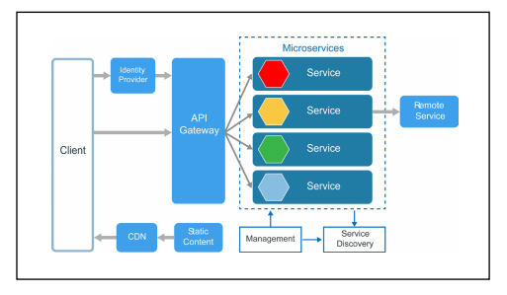
Microservices

Slide 9
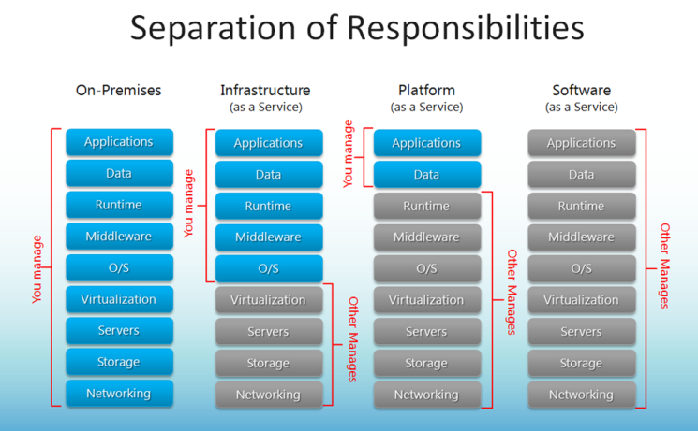

Slide 10
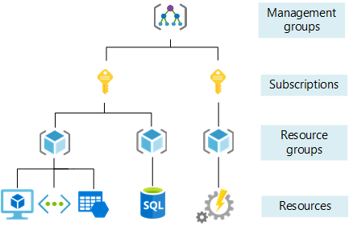

Slide 11
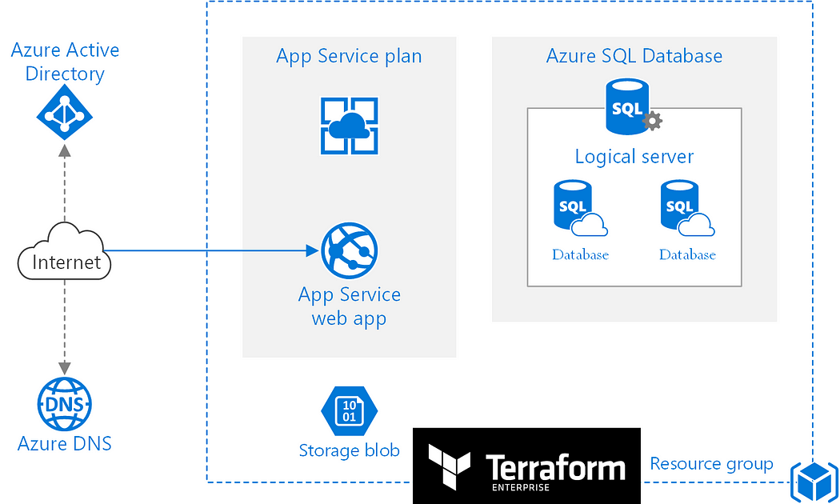

Slide 12
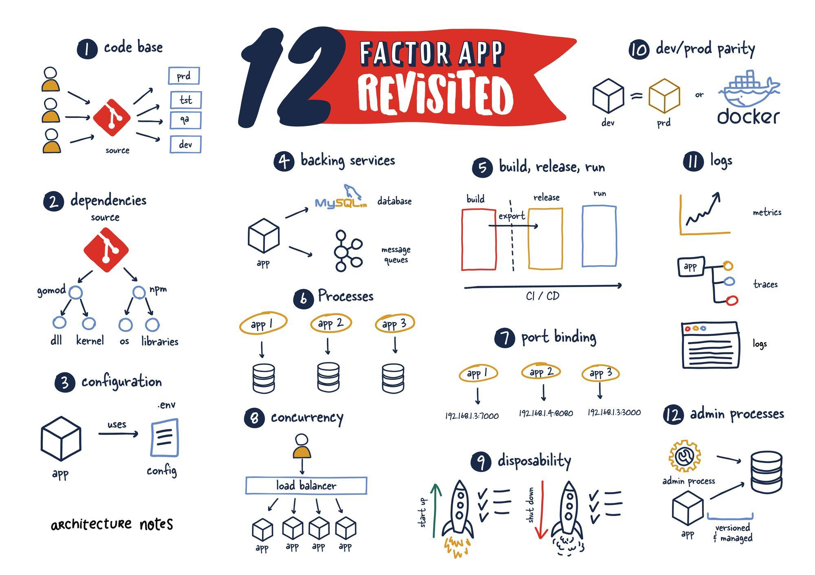

Slide 13
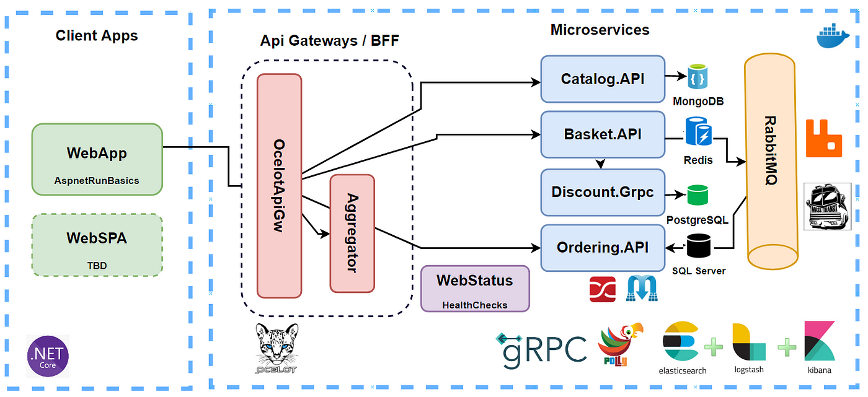

Slide 14
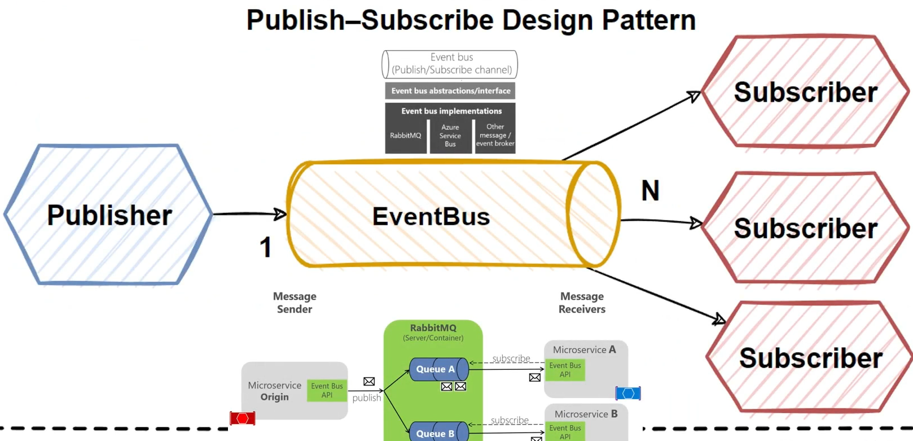

Slide 15
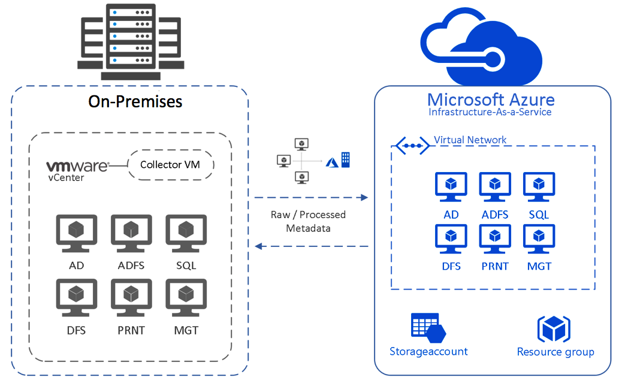

Slide 16
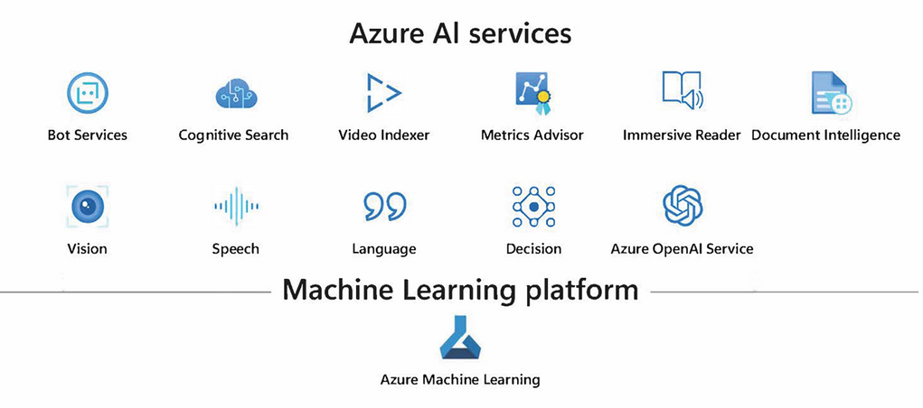

Slide 17
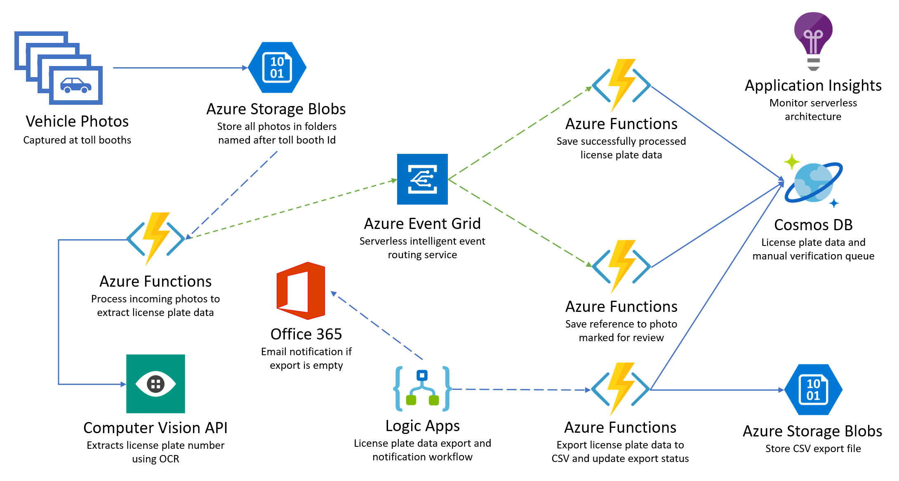

Slide 18
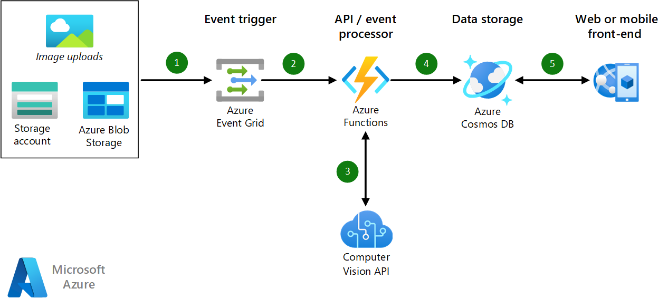

Slide 19
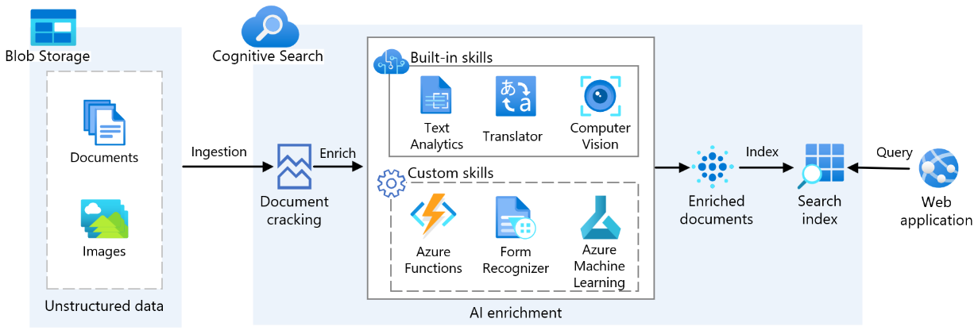

Slide 20
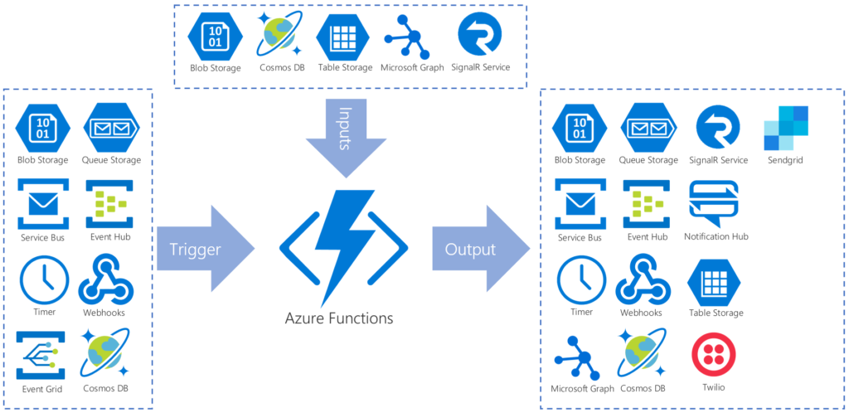
Azure Function

Slide 21
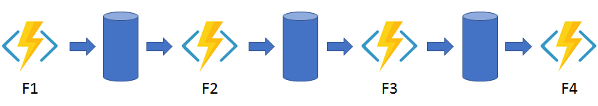
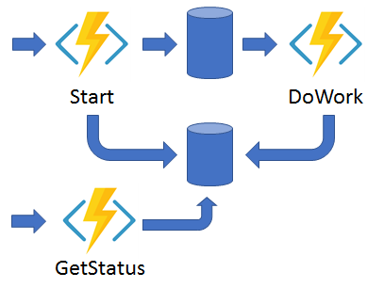
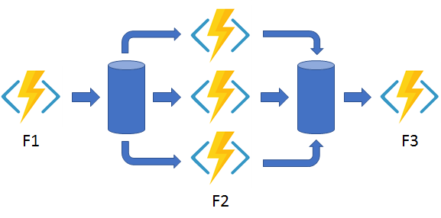
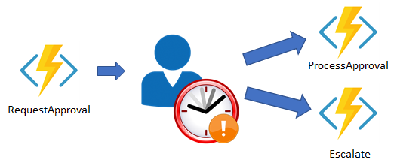
Azure Function
Function chaining
Async HTTP APIs
Monitoring
Fan-out/fan-in
Human interaction

Slide 22
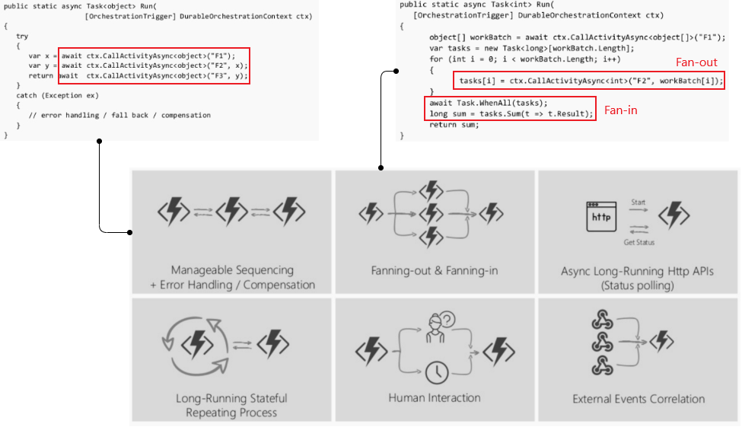

Slide 23
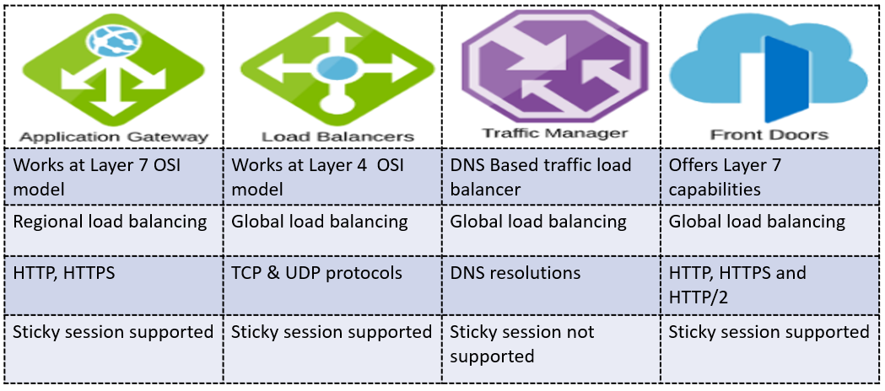

Slide 24
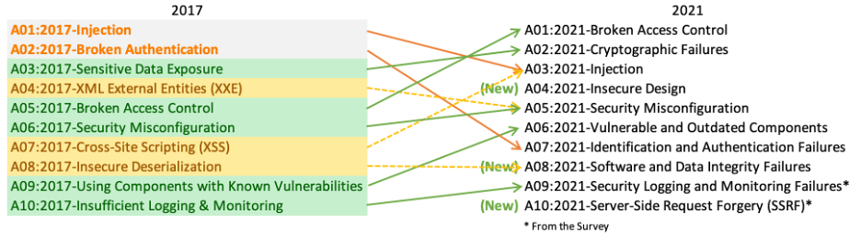
OWASP- Open Worldwide Application Security Project

Slide 25
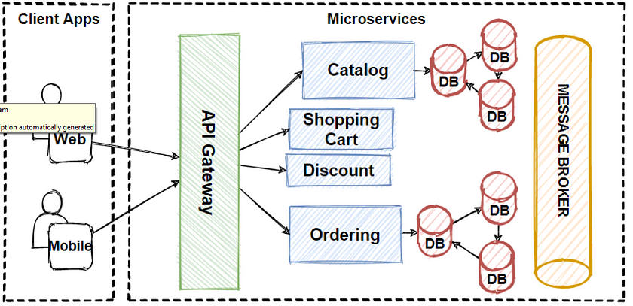
Database Shading Pattern for Scaling Microservices Database Architecture

Slide 26
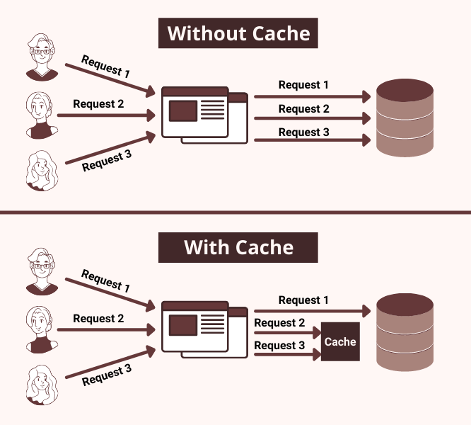

Slide 27
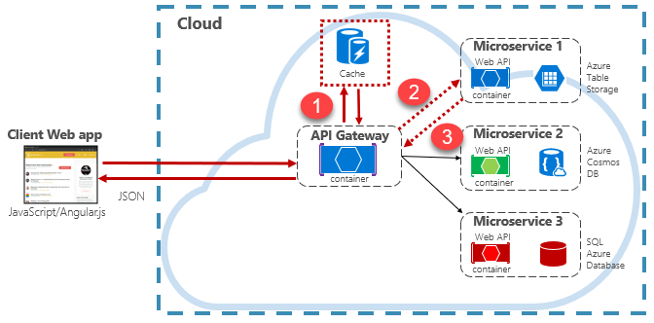

Slide 28
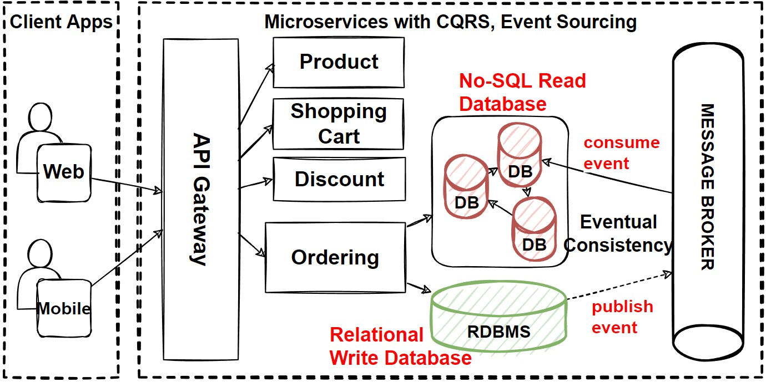

Slide 29
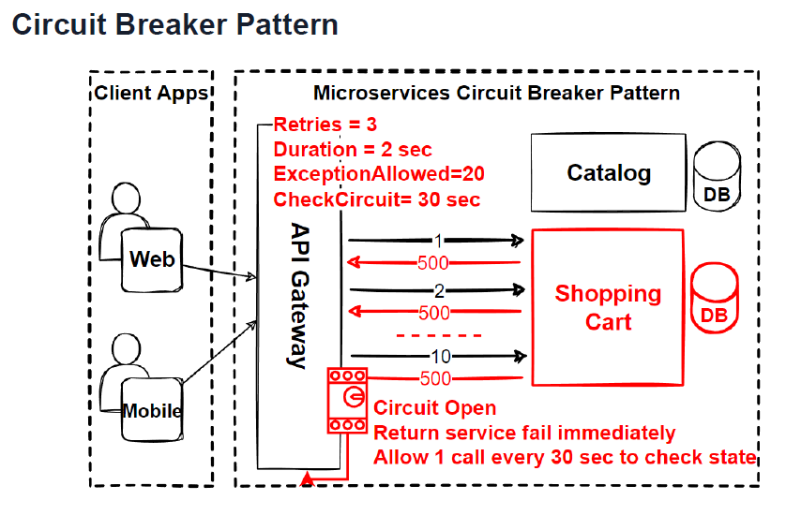

Slide 30
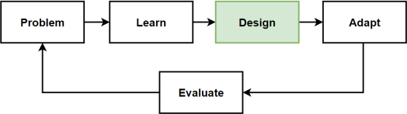
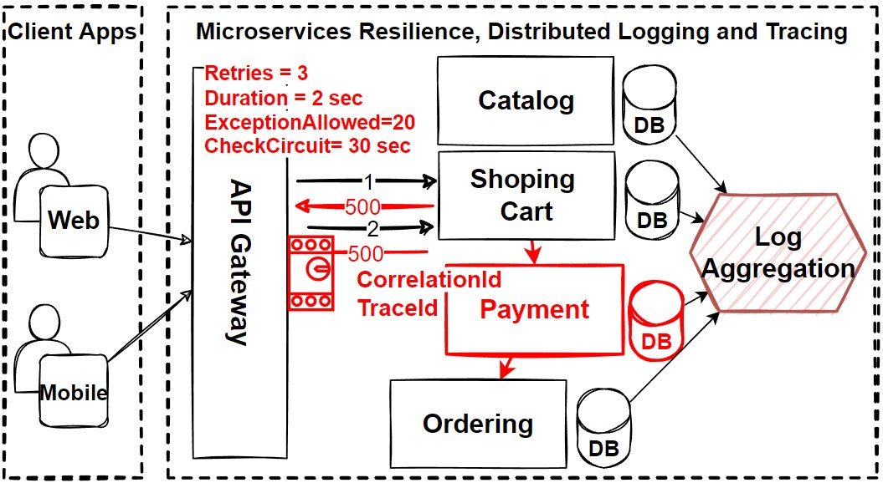

Slide 31
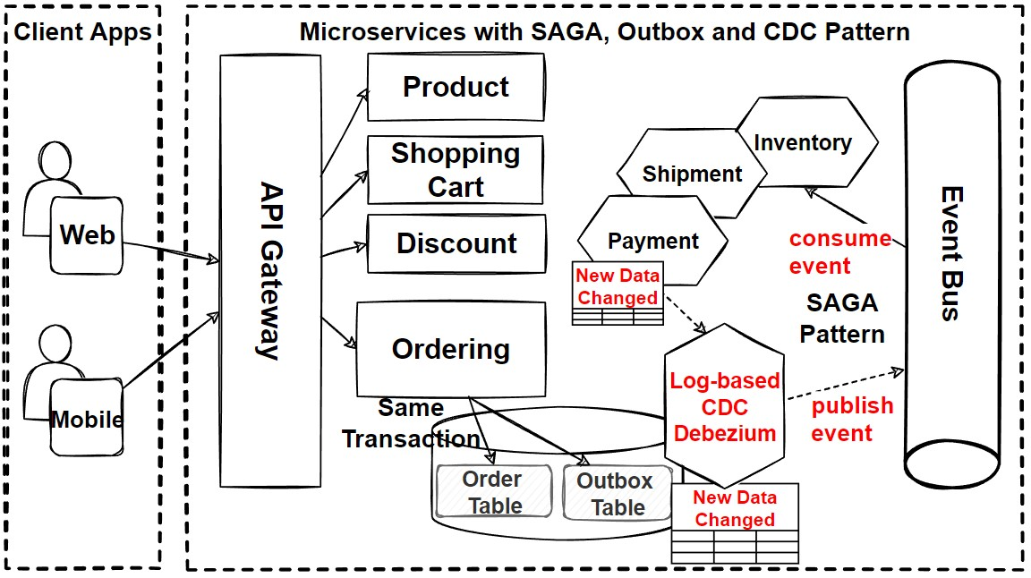

Slide 32
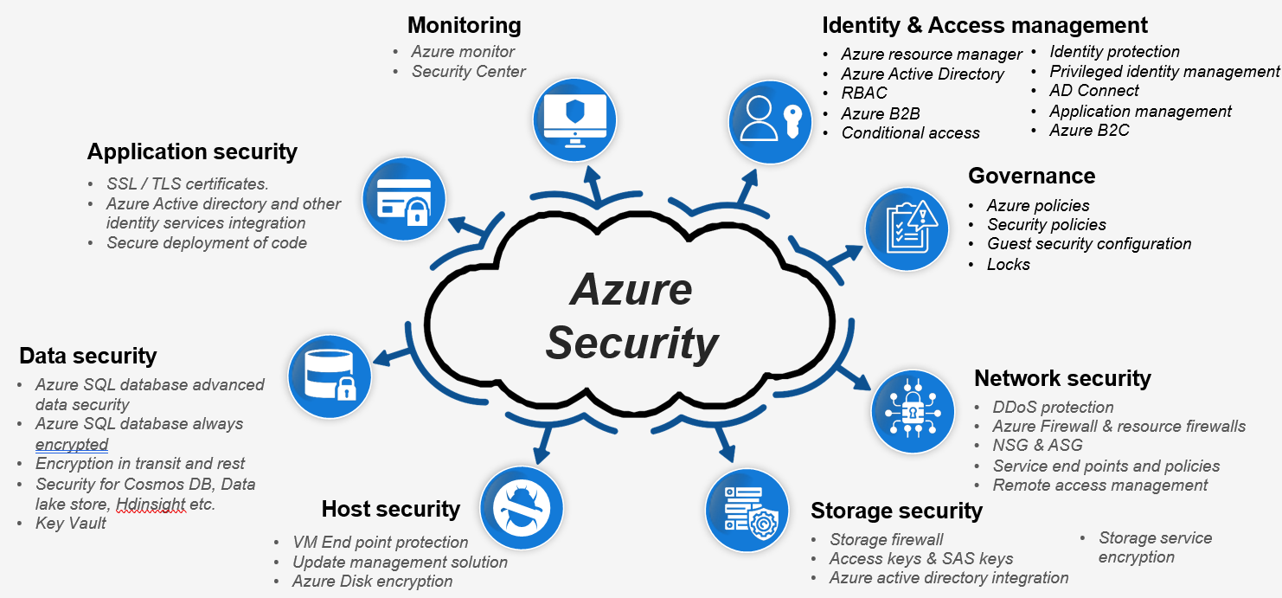

Slide 33
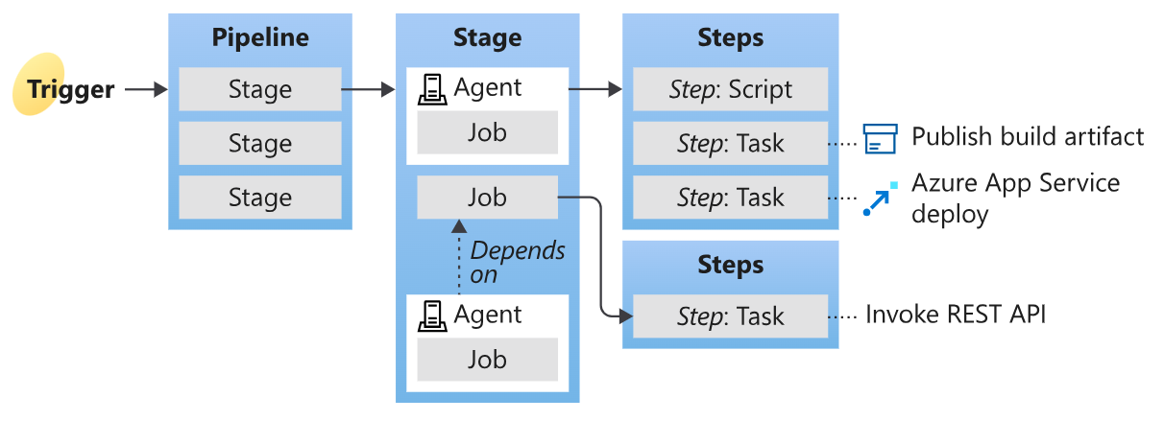

Slide 34
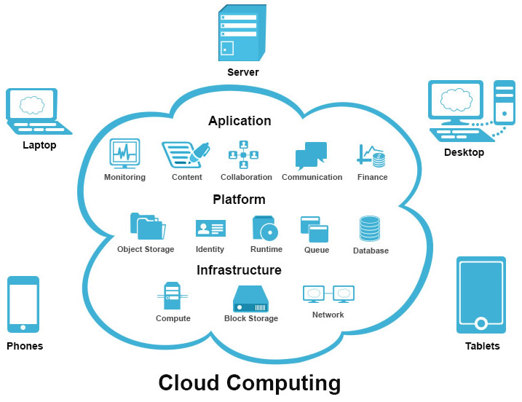

Slide 35
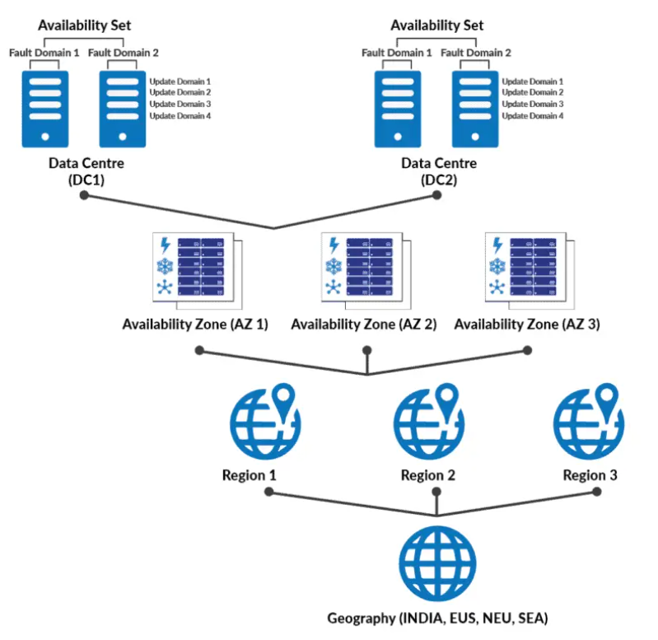
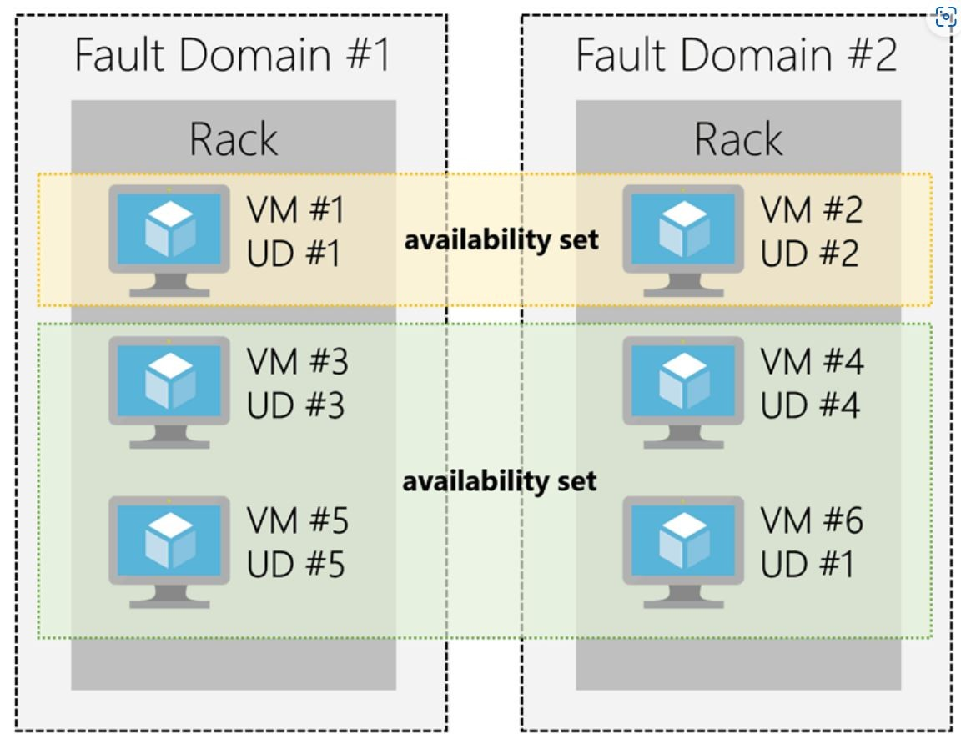

Slide 36
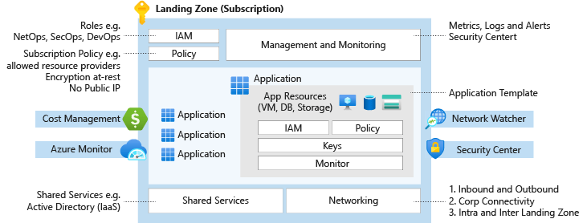

Slide 37
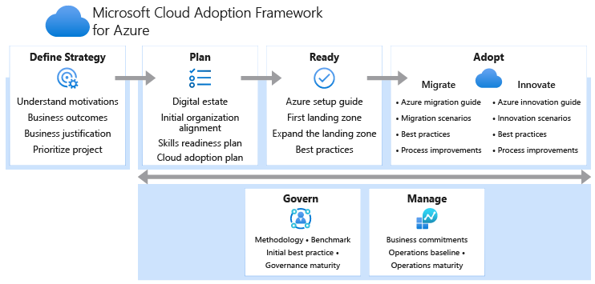
Cloud Adoption Framework (CAF)

Slide 38
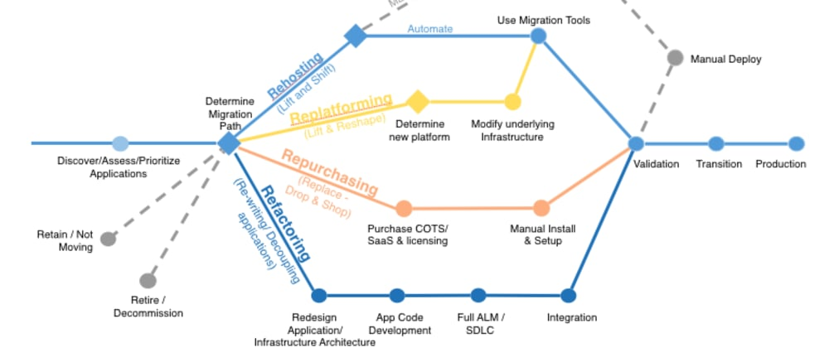
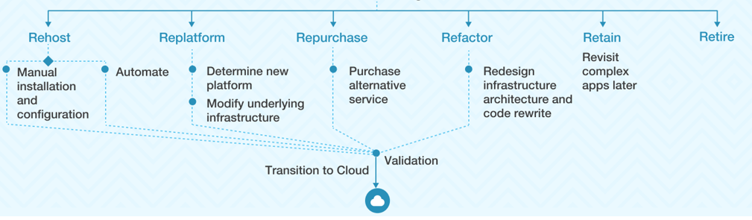
6R Strategy

Slide 39
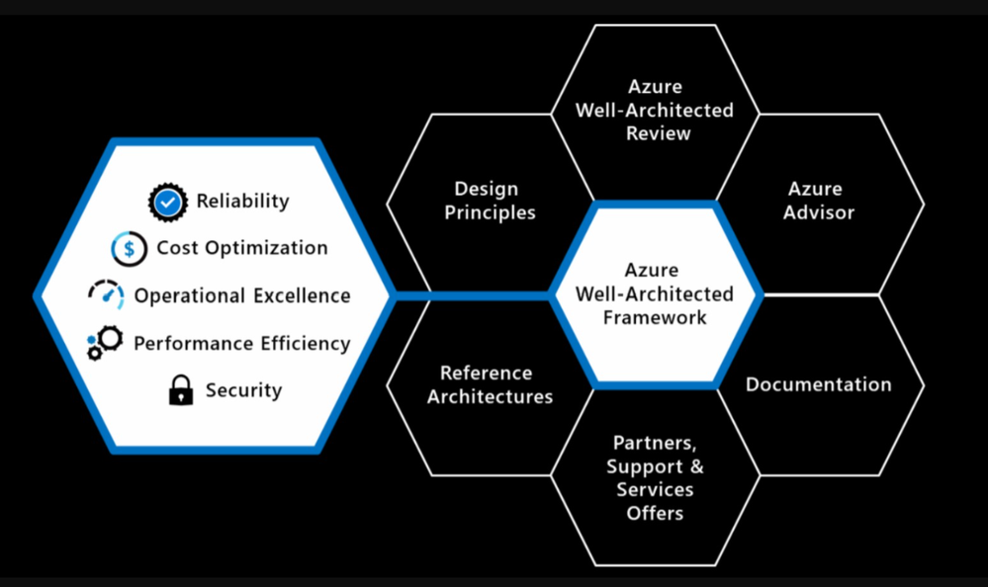

Slide 40
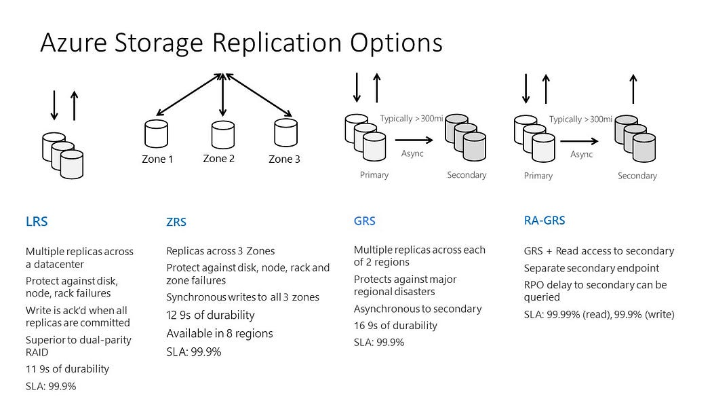
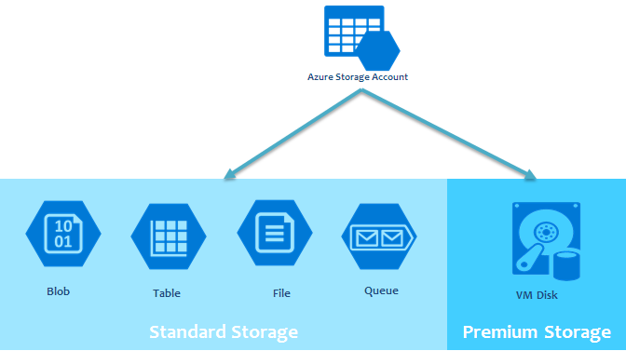
Azure Storage

Slide 41
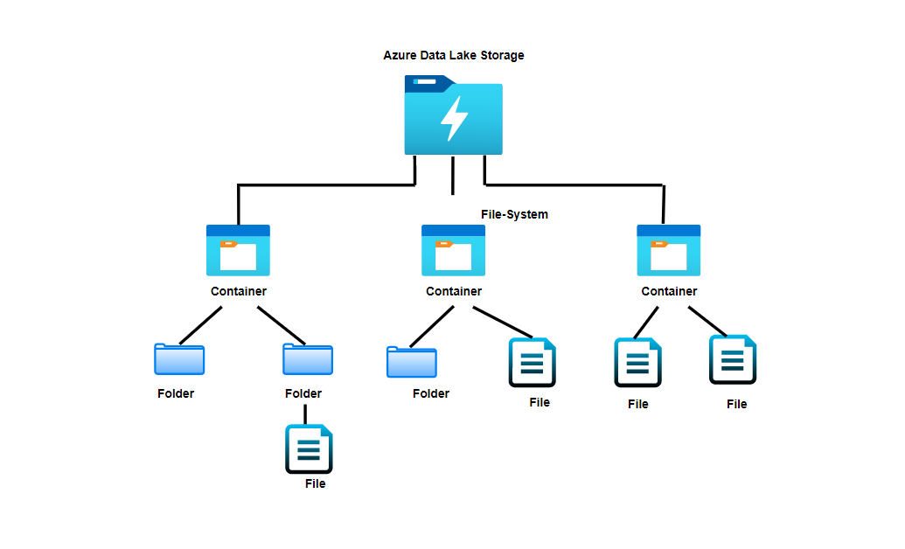
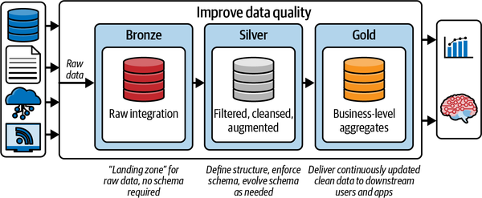
Azure Data lake storage (ADLS)

Slide 42
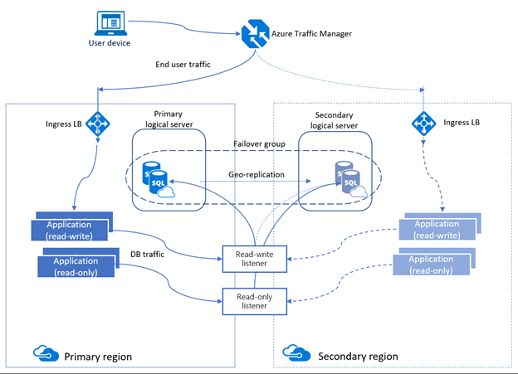

Slide 43
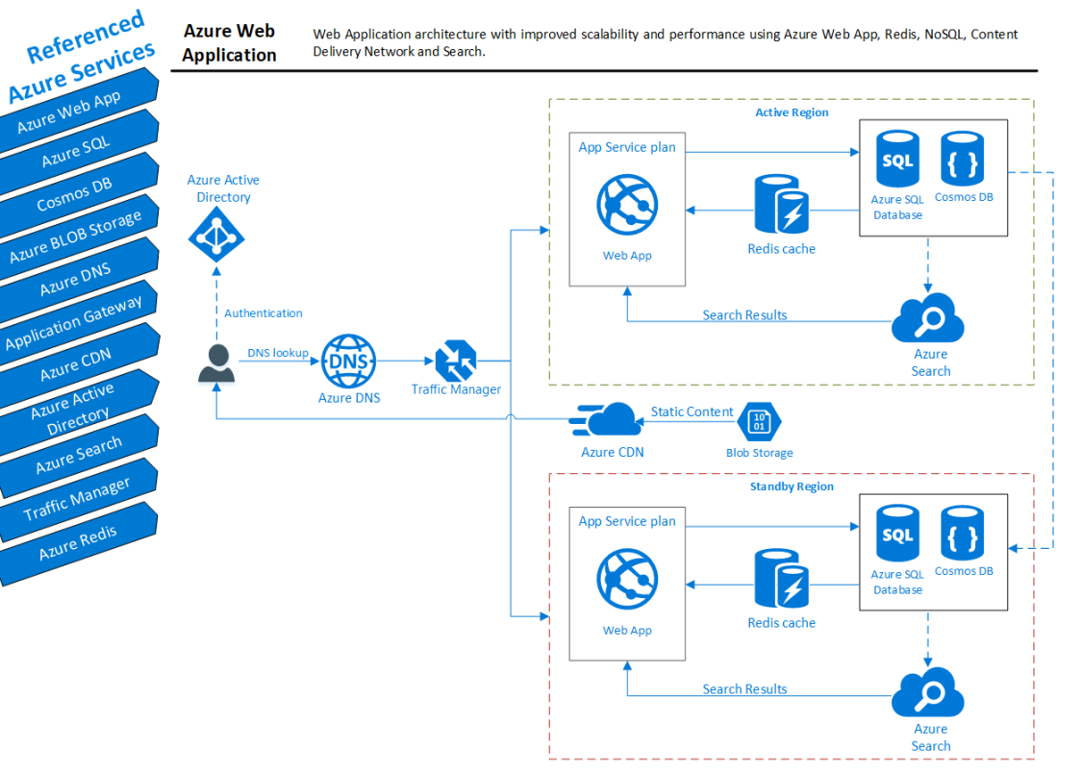

Slide 44
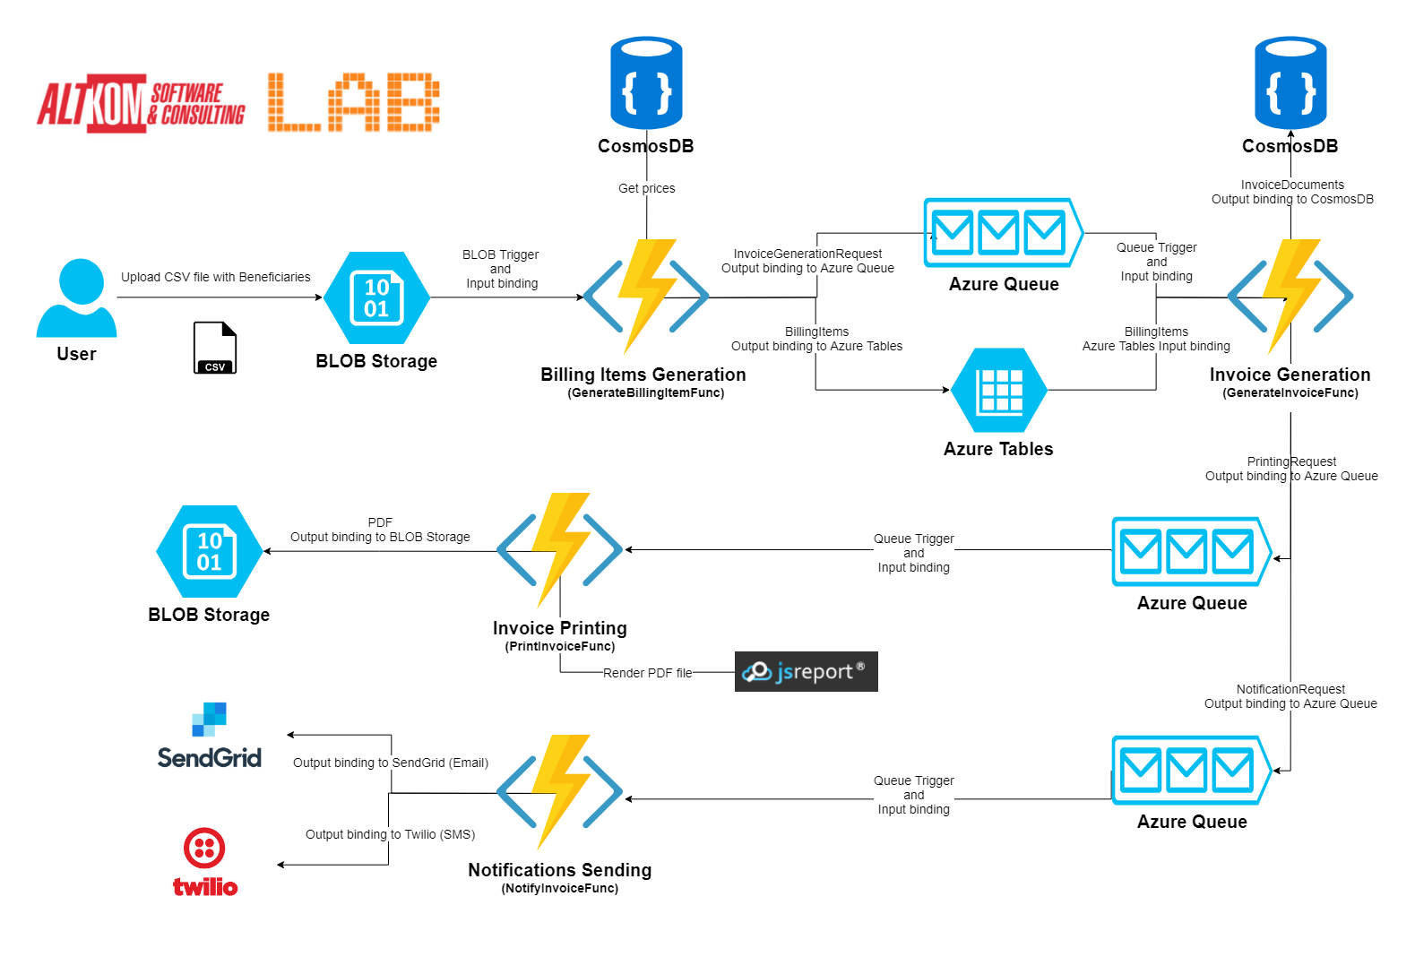

Slide 45
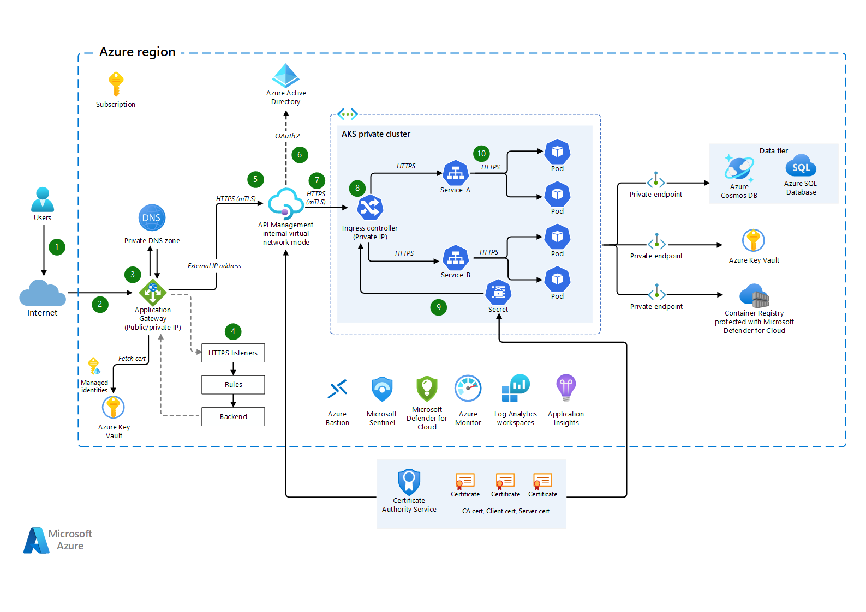

Slide 46
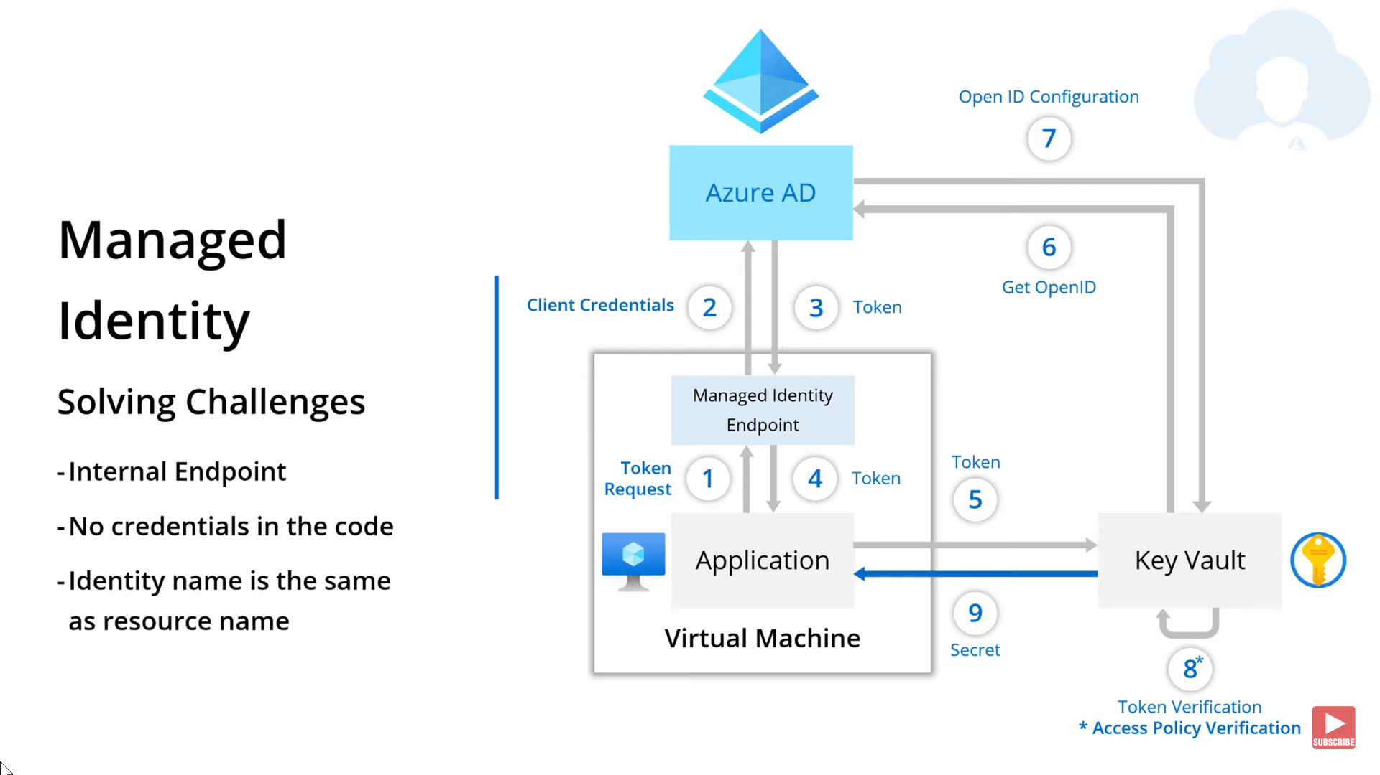

Slide 47
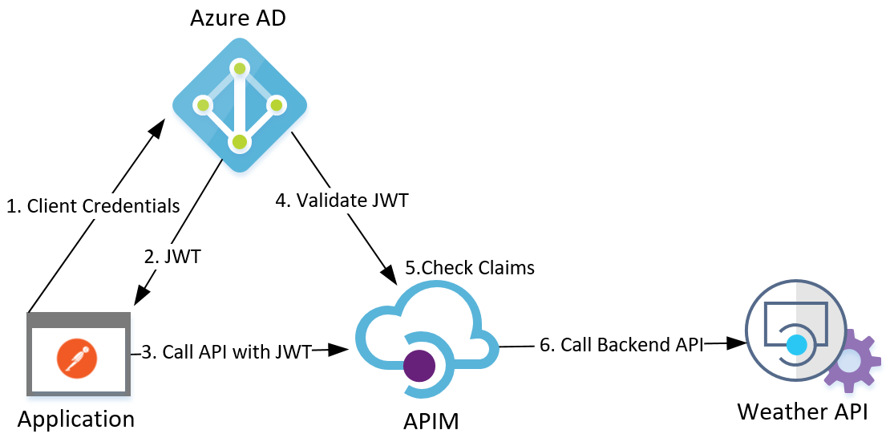

Slide 48
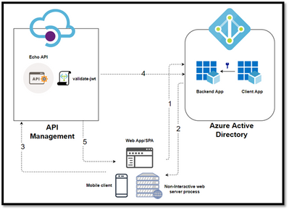

Slide 49
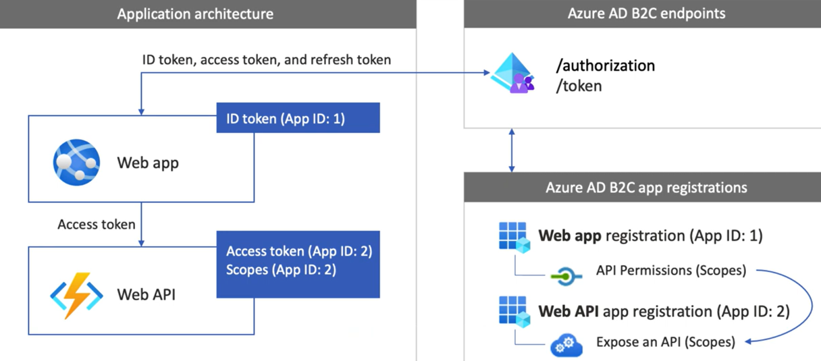

Slide 50


Slide 51


Slide 52


Slide 53


Slide 54


Slide 55


Slide 56


Slide 57


Slide 58


Slide 59


Slide 60


Slide 61


Slide 62


Slide 63


Slide 64


Slide 65


